Slide 1
Finding NSE using even quantiles, and developing Marc’s power law recession
Feb 21, 2018

Slide 2
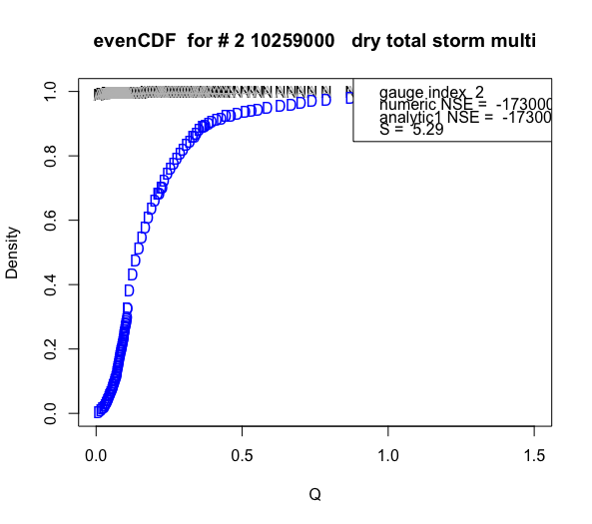
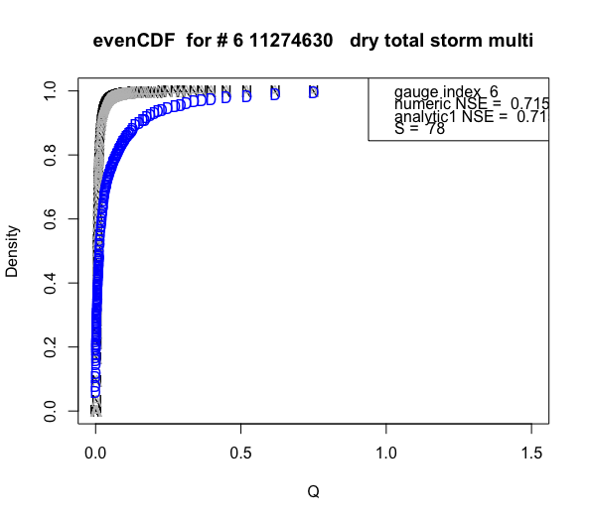
Improving NSE stability: does having the same counts in each bin help?
Took out zero flows from data to create CDF, which was set to quantiles in increments of 5% (also tested 10% to 0.5% increments)
Compared CDF of non-zero flow data to analytic CDF of total flow in marc’s equation.
Is it fair to compare positive flows in data to all flows in prediction?
Is there a way to find atom of probability at zero for the prediction?
Worst agreement
Best agreement
Note, these are before (a, b) recession constants are finalized
R Code: Testing Marc Seasonally Dry v2.R

Slide 3
Power law recession fitting with Marc’s method
Find qo, which is the streamflow value at the last peak before the end of the wet season. End of wet season was identified by the step fit over all years (for now)
A peak was defined as whenever dQ_total/dt changed from positive to negative, where the positive change should be greater than some threshold. Then, qo = local max of baseflow was then found near the place this Q_total peak was found.
Like Marc, began by looking in the wet season for this peak. However, in places where there are no suitable peaks found in wet season, move into start of dry season to find peaks. If still no suitable peaks, then skip the year. Marc looked for peaks only in the wet season, but sometimes it appears the peak is within the dry season.
Didn’t use baseflow for identifying peaks because baseflow peaks aren’t very sharp or obvious. Also baseflow is highly dependent on baseflow separation.
Set the location of the specific year’s start of dry season as the location of qo. Otherwise, esp if the qo is located far from the overall start of dry season, agreement will be off.
a and b were calibrated stochastically to minimize sum of squared errors. Estimates are found using simulated annealing. Note sure what function Marc used; I used optim(method = “SANN”)
R Code: FCN_findLastSeasonPeak.R, power law recession Marc’s Way.R

Slide 4
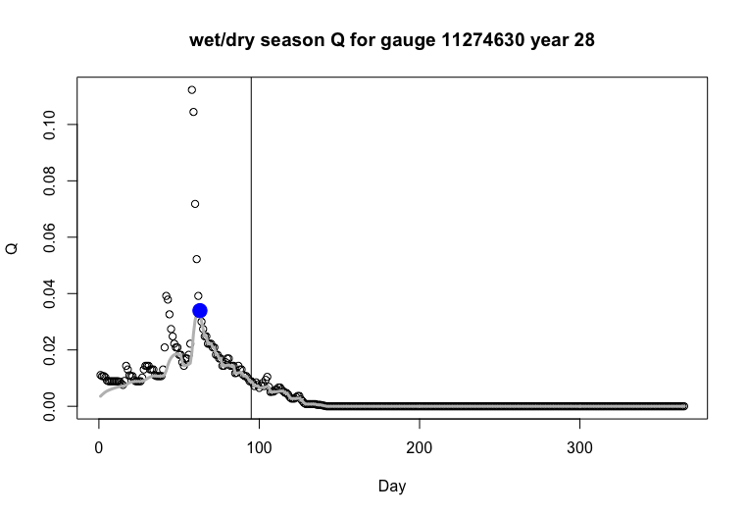
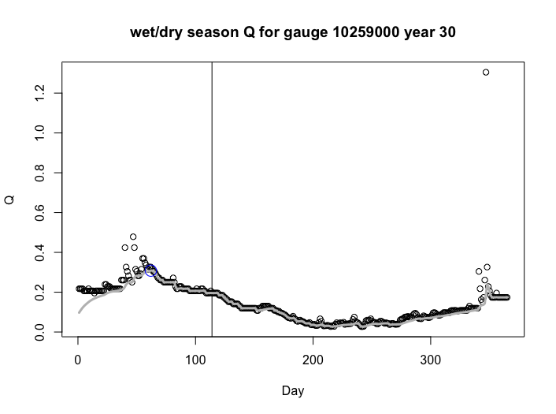
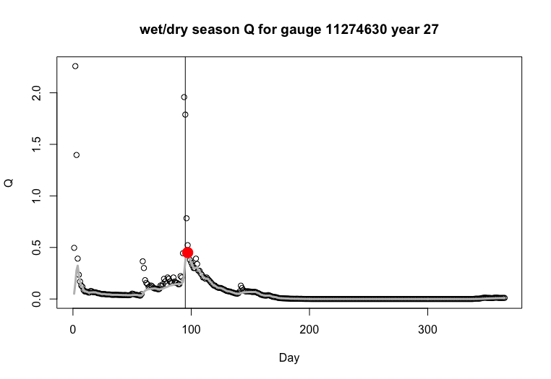
The colored dots represent the qo.
Gray line is baseflow.
Black dots are total flow.
Vertical line is wet/dry separation.
All of these begin on first day of wet season.
If the qo found is too far from the end of wet season, plot as open circle.

Slide 5
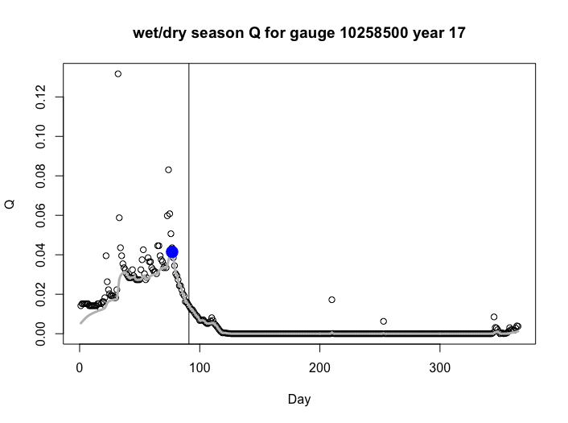
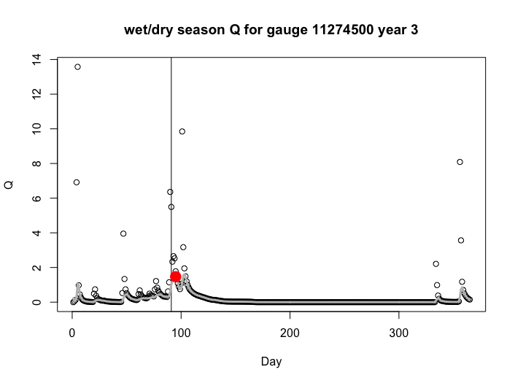
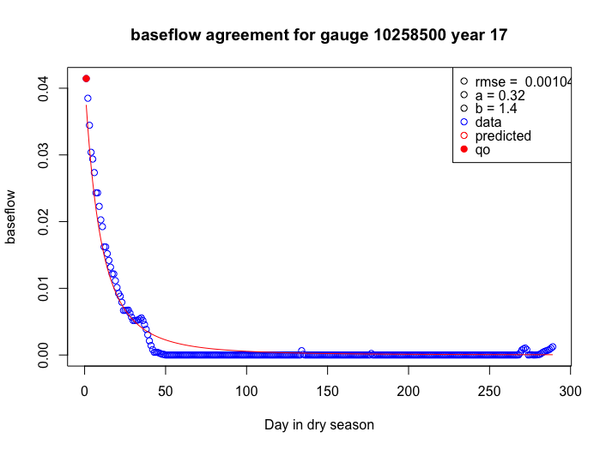
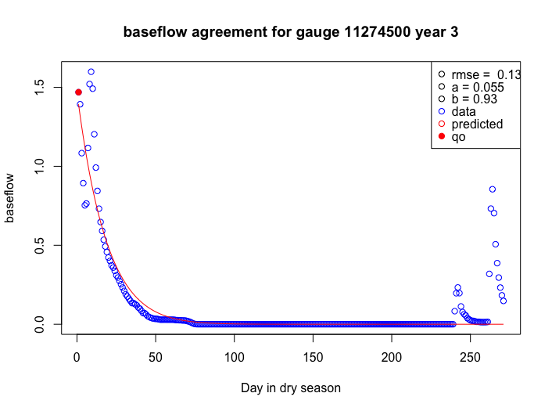
Example of power law recession fitting, after determining the qo (blue or red dot)

Slide 6
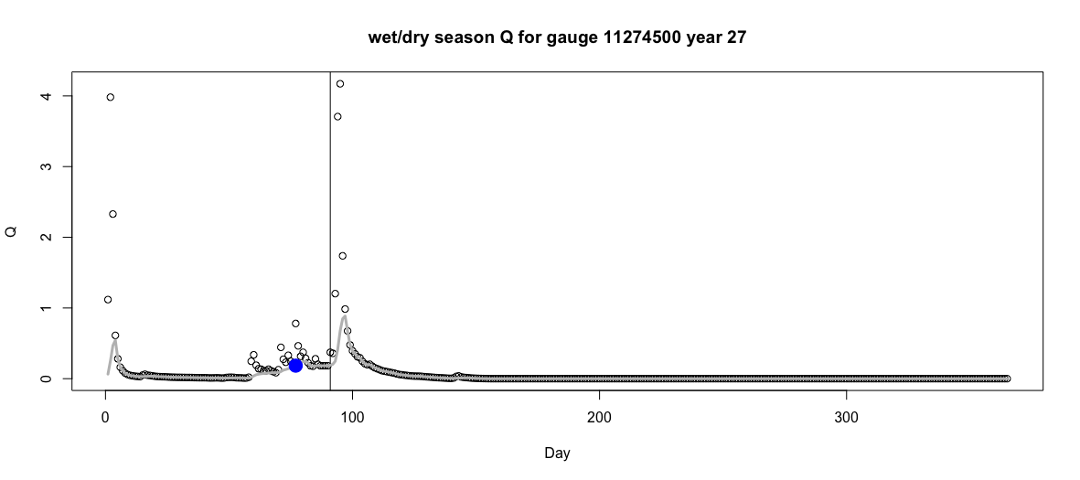
Issue 1: because the code looks first at wet season to see if there are peaks, it may miss an even “better” peak in the dry season.
Loosely interpret Marc’s paper so that qo doesn’t have to be in the wet season, but rather anytime close to the wet/dry season split?

Slide 7
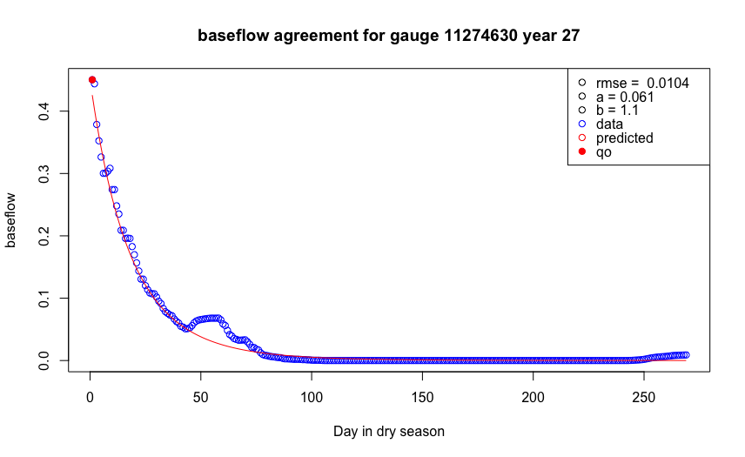
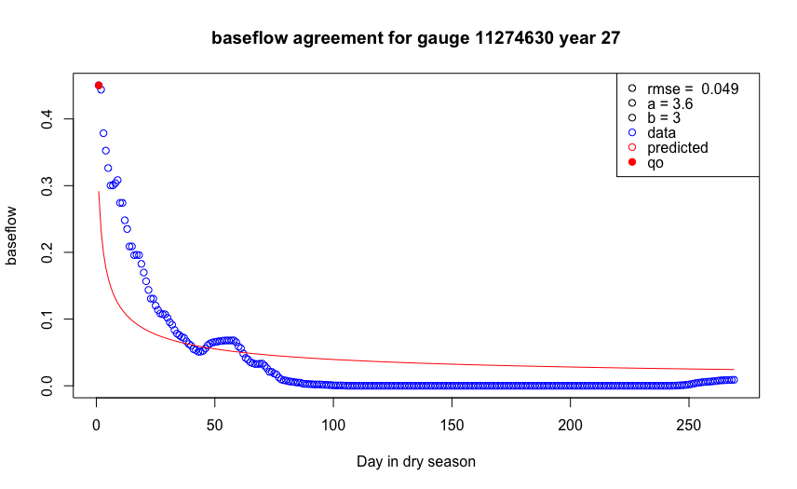
Issue 2: The optim() function with method = “SANN” was used to find a and b, but it doesn’t seem very stable. The following were just repeat runs of the exact same code.
Are there better ways to do simulated annealing?
R code: power law recession Marc’s Way.R

Slide 8
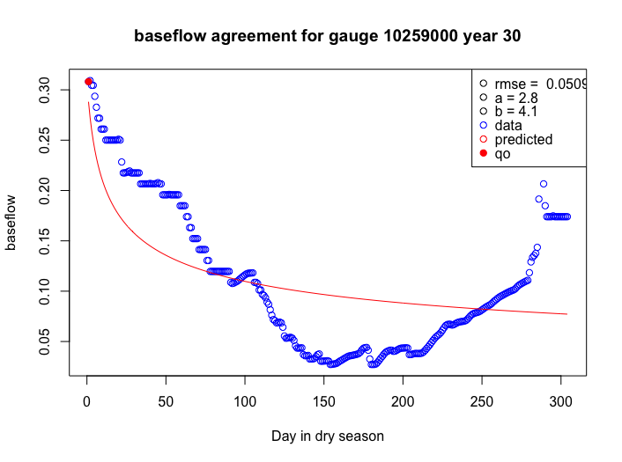
Issue 3: sometimes the dry season vs. wet season delineation is bad.
Still need to step fit individual years.

Slide 9
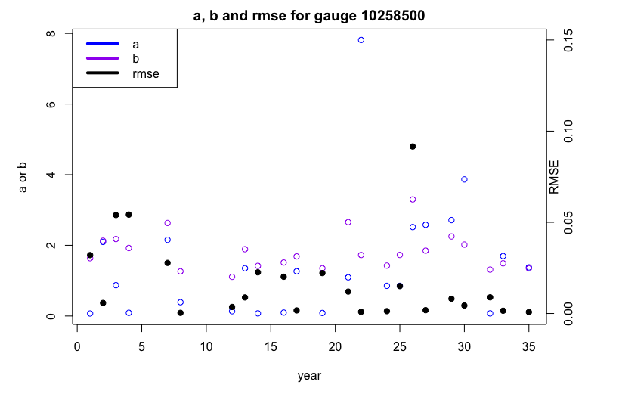
R code: power law recession Marc’s Way.R

Slide 10
Questions
It looks like the recession rates will be very different each year in the same gauge. Why is this ok? Doesn’t recession depend on soil and aquifer properties? These shouldn’t change much across years.
How will we find duration of dry season if we don’t have flow data? [equation for Td <- Td_rain doesn’t make sense]
How many days before start of dry season can we reasonably set the “last peak of wet streamflow”?
Once the position of qo was found, did Marc shift the start date of the dry season in order to apply the Qd(t) equation? [I shifted it]

Slide 12
This section:
experimented with calculating the NSE of CDFs with even # counts per bin, i.e. CDFs by quantile
began calculating (a, b) power law recession parameters using the same way Marc did in his seasonally dry paper

Slide 13
NSE stuff: does having the same counts in each bin improve NSE stability?
New function FCN_findQuantileCDFs.R (called by Testing Marc Seasonally Dry v2.R)
First takes out all “zero” flows from consideration
Takes desired quantiles and turns them into the corresponding flow rates; uses these flow rates to find data’s CDF and also calculates analytic CDF for dry season
This is called “evenCDF” because the number of counts per bin is held at a consistent number
Results:
Gauges 4-6 do better than gauges 1-3 for when considering both PDF and CDF matches, and evenCDF doesn’t really give an advantage in terms of improving NSE (actually, NSE actually turns very very negative for gauges 1-3), but the advantage of evenCDF over CDF is that bin counts are uniform and therefore don’t need to worry about sensitivity to number of bins.

Slide 14
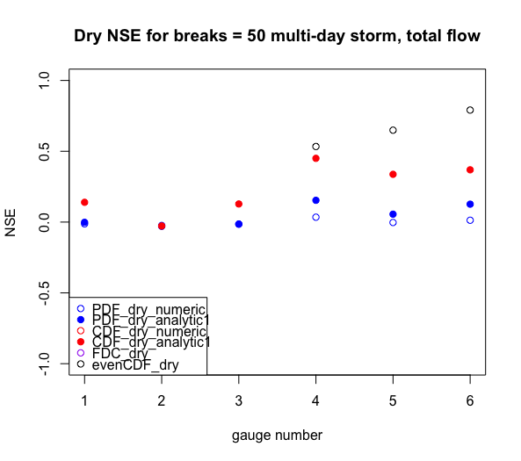



For the below, look specifically at the open black dots. Quantile intervals change for those only.
Ignore the breaks = 50 part, that’s for the colored dots. Gauges 5 and 6 are insensitive to quantile choice but gauge 4 is. Why? [Because 5 and 6 have more points near CDF= 1 that balances out the inaccuracies in the middle of the CDF]
Quantiles: every 0.1
Quantiles: every 0.05
For now, go on to power law recession stuff using quantiles at every 0.05
Is there a way to find atom of prob at zero for the prediction?
Right now we’re just comparing the CDF of the positive flow data to the analytic CDF in marc’s equation. Is this a fair comparison?
Quantiles: every 0.01
Quantiles: every 0.005
R Code: Testing Marc Seasonally Dry v2.R

Slide 15
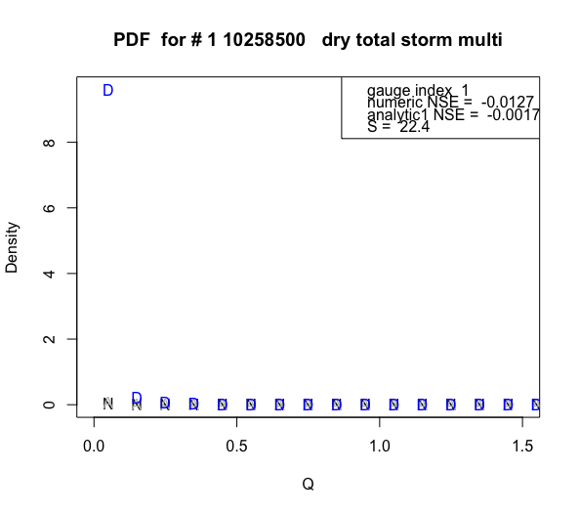
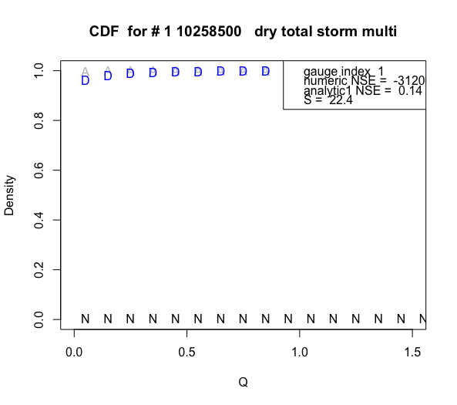
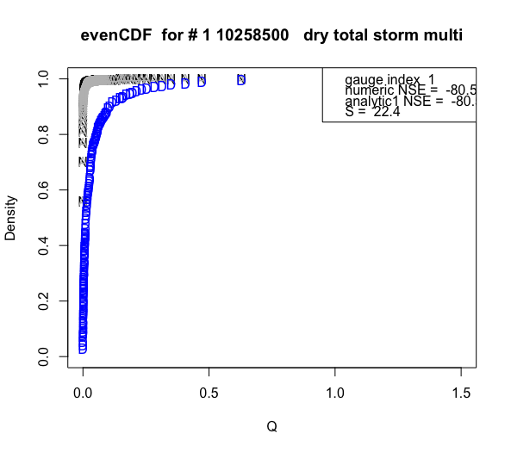
NOTE that none of these have accurate a, b power recessions yet so these graphs aren’t finalized
R Code: Testing Marc Seasonally Dry v2.R

Slide 16
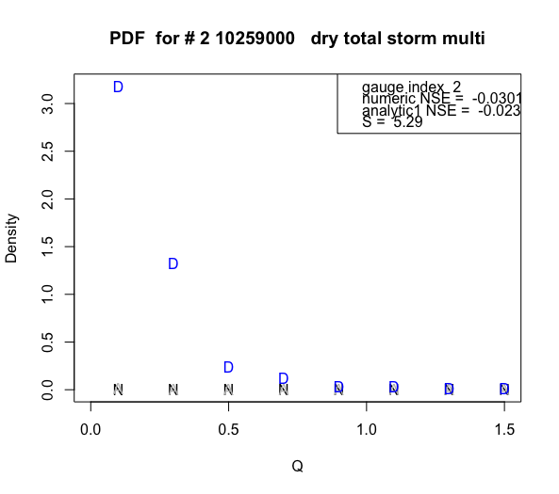
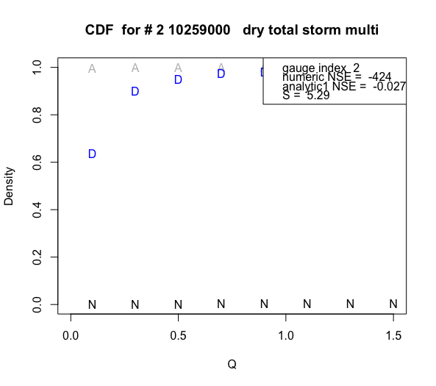
R Code: Testing Marc Seasonally Dry v2.R

Slide 17
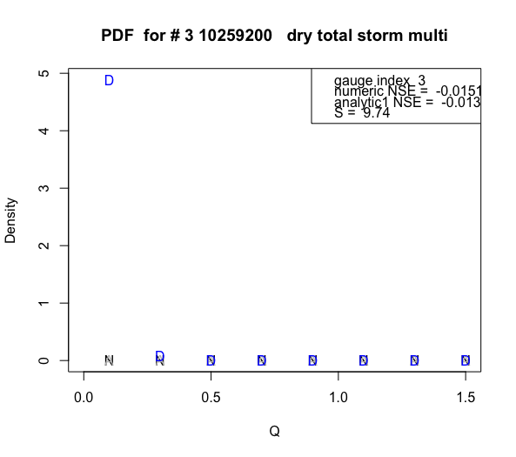
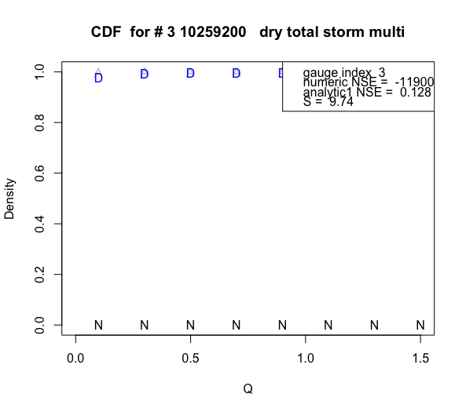
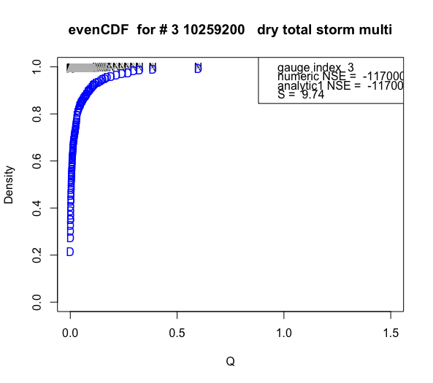
R Code: Testing Marc Seasonally Dry v2.R

Slide 18
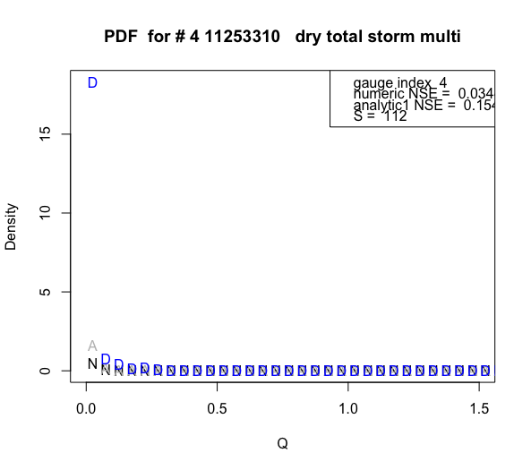
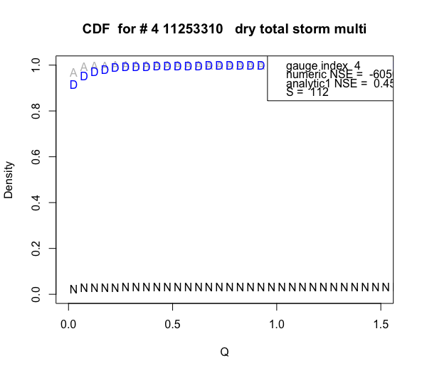
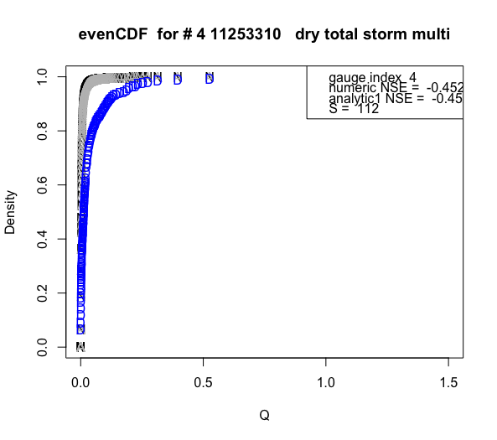
R Code: Testing Marc Seasonally Dry v2.R

Slide 19
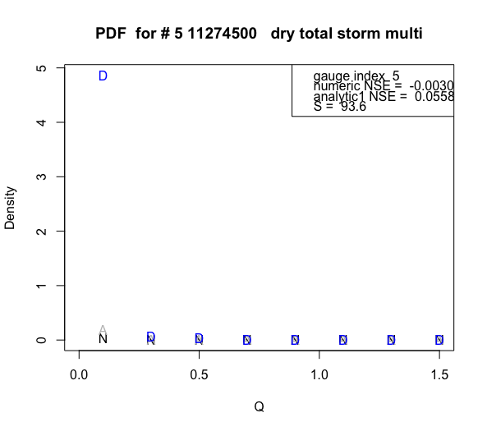
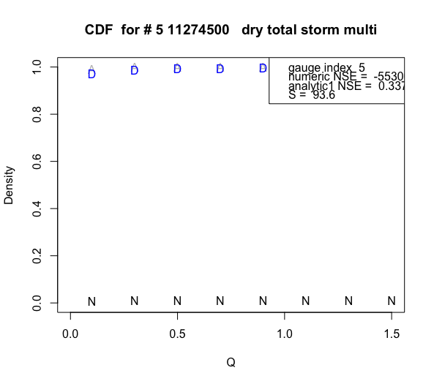
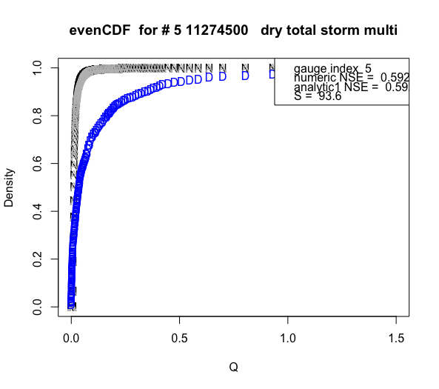
R Code: Testing Marc Seasonally Dry v2.R

Slide 20
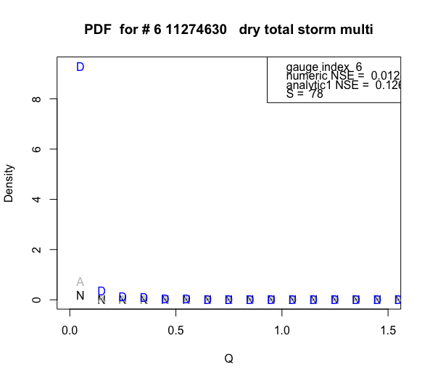
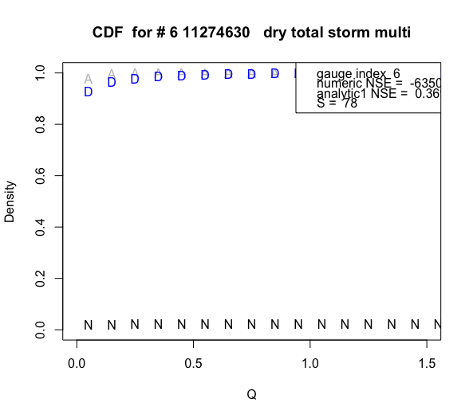
If there are a larger number of very high Qs, Nse is likely to be higher because there will be more matches near CDF = 1
This is why gauge 4 wasn’t as good as gauges 5 and 6
R Code: Testing Marc Seasonally Dry v2.R

Slide 21
Tried Marc’s way to find a and b power recession:
Qo is the streamflow value at the last peak before the end of the wet season as identified by the step fit over all years
Estimates of a and b are calibrated stochastically to minimize sum of squared errors between the modeled and observed dry season base flow across all years. Estimates are found using simulated annealing from (Belisle, 1992)
The base flow separation method was the Lyne Hollick algorithm
NOTE: the evaluation metric he uses is NSC for FDC applied to the flow quantiles (350 in all? Or what? – look at Eqn 24). Took log of the flow quantiles before finding NSC to remove effect of very large floods
Equation 23 also gives an alternative way to find a, but b is needed first
Used error-duration curves (Pugliese et al, 2013) to assess the repartition of errors across flow quantiles

Slide 22
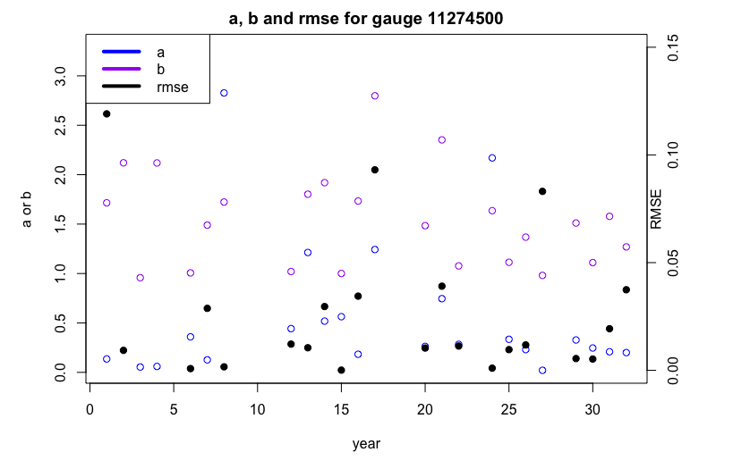
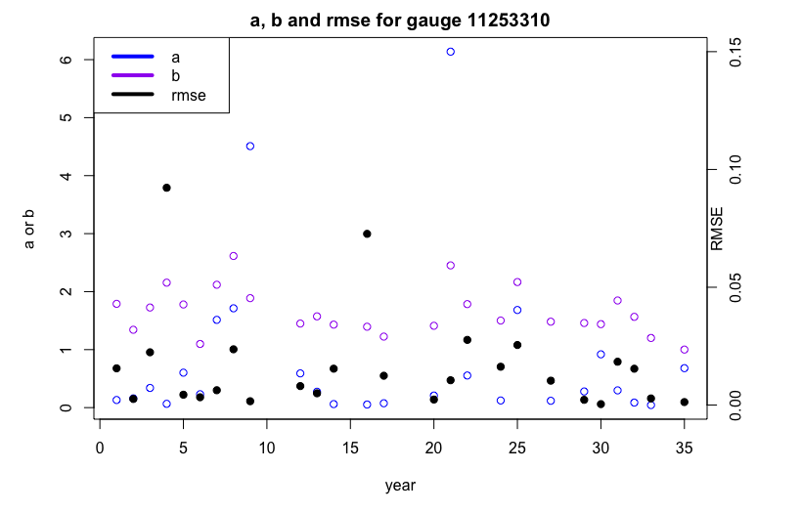
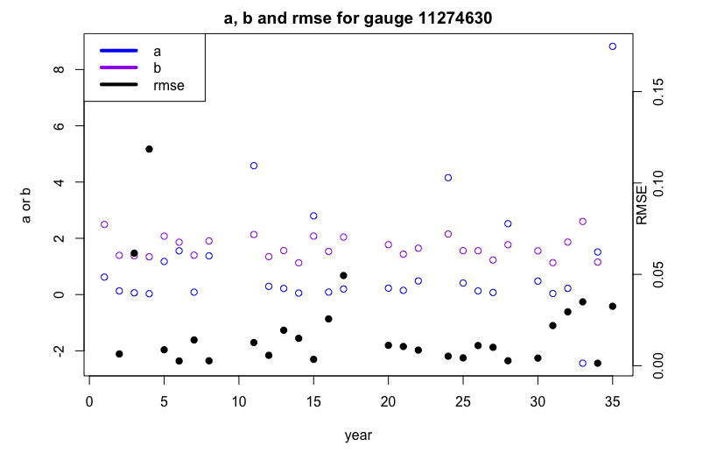
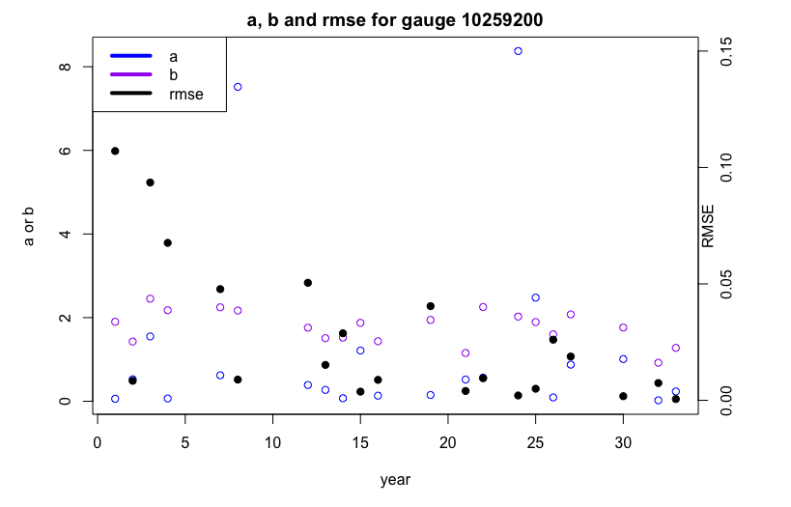
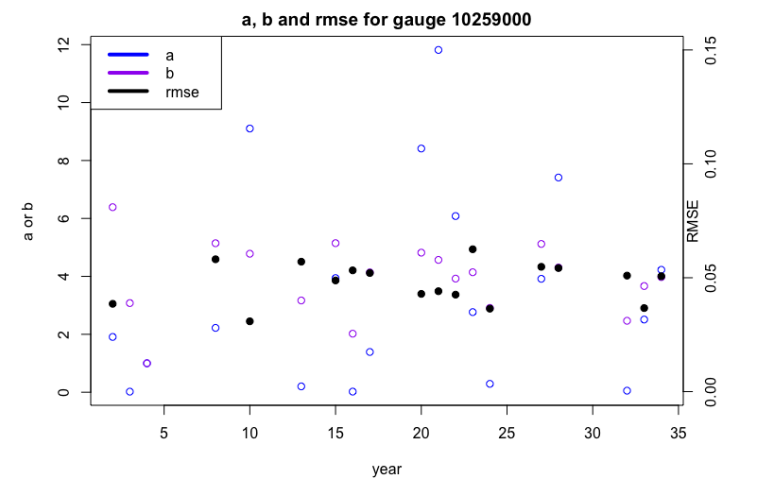
R code: power law recession Marc’s Way.R

Slide 23
FCN_findLastSeasonPeak.R: code explanation
This code supports Marc’s way of fitting power law recession by finding qo (the last wet season peak)
This function was developed from find last wet season peak.R
This is to find the value and date of qo (from Marc’s paper, qo is strictly the last peak in the wet season, but in this code, if no acceptable wet season peak is found, step into the following dry season to find the peak. This is because the line demarcating wet vs. dry season may not be perfect)
First, look at wet season. Moving back in time from the wet/dry change, look at peaks (defined as when dQ_total/dt changes from positive to negative). Then, choose the first peak that meets a certain threshold slope (which is defined by a certain percent of the max flow in that season). Also tried minimum dQ/dt threshold = constant*mean(wetQ) in order to figure out what counts as a peak and what is a slight error in the streamflow record. However, using max(wetQ) seems more “stable”, since mean is impacted by number of zero flows.
If no peaks exist in wet season, march forward in time in the dry season with its own slope threshold. The day on which Q_total meets the criteria threshold is set as peakPosition, which counts from the first day of the wet season.
Finally, look at the local max of baseflow around the peakPosition. Adjust peakPosition to match up with the local max of baseflow (because baseflow doesn’t usually peak on same day as surface flow). This baseflow peak location is peakPosition_adj.
If no peak is found all year, end the run and ignore qo, peakPosition calculations.
The value of qo is the baseflow on the day of peakPosition_adj

Slide 24
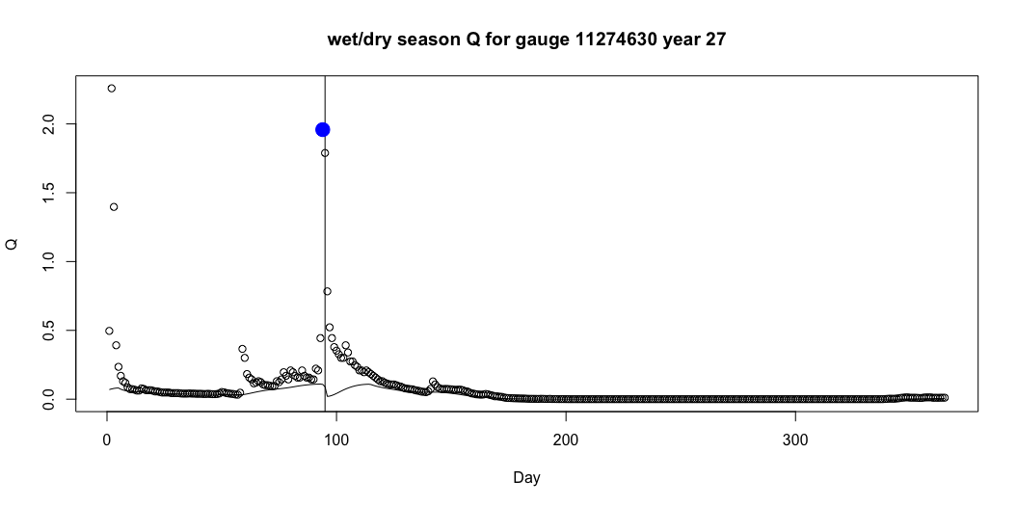
The problem below is that I found baseflow for wet and dry seasons separately – need to first concatenate them into a single timeseries, find the baseflow, and THEN separate into dry and wet season.

